Slide 1
Eric Zhao
Midterm
Presentation

Slide 2
Eric Zhao
ericzhao05.com
Page | 01

Slide 3
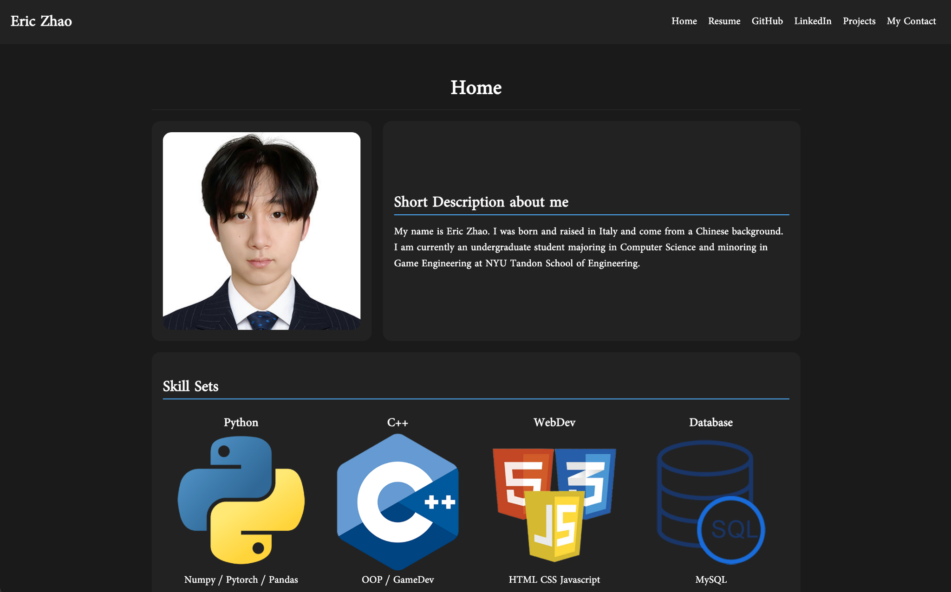
Eric Zhao
Page | 02

Slide 4
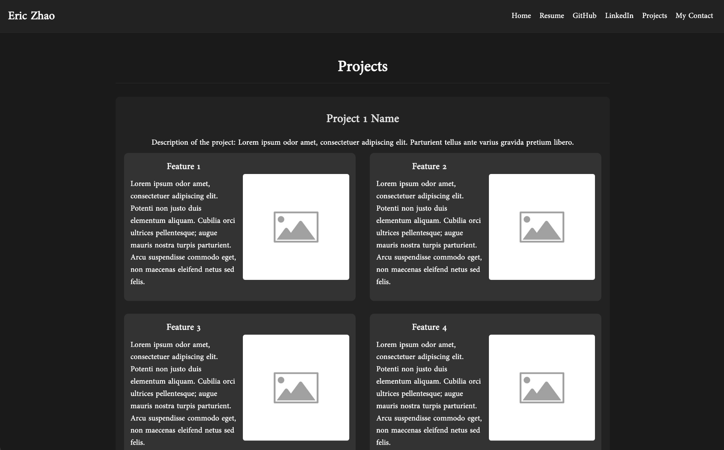
Eric Zhao
Page | 03

Slide 5
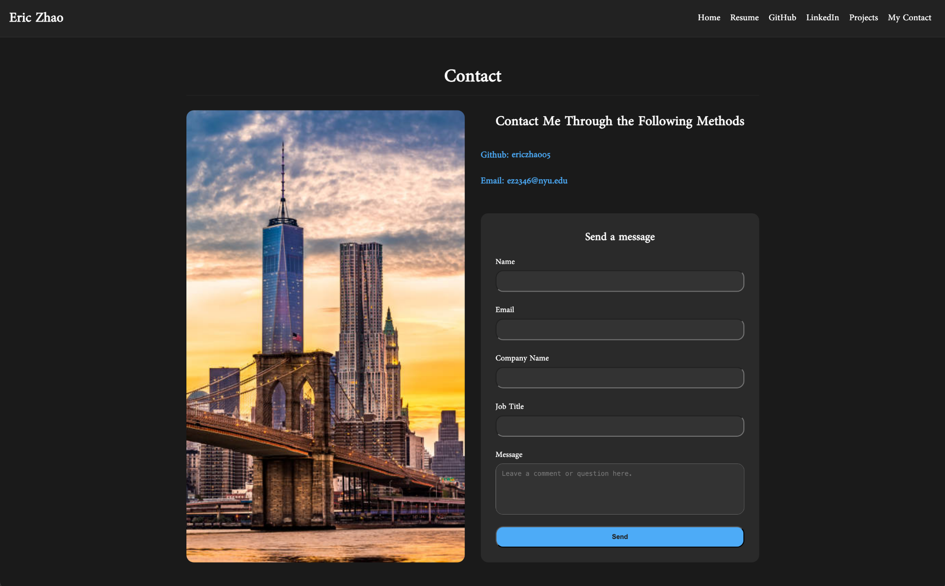
Eric Zhao
Page | 04

Slide 6
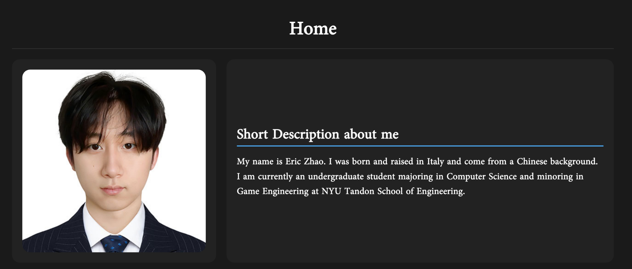
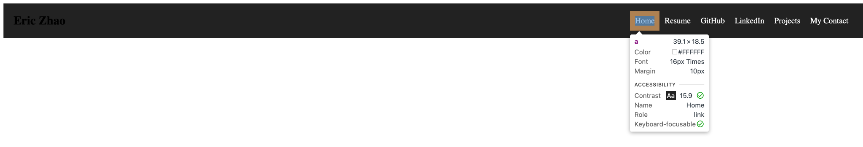
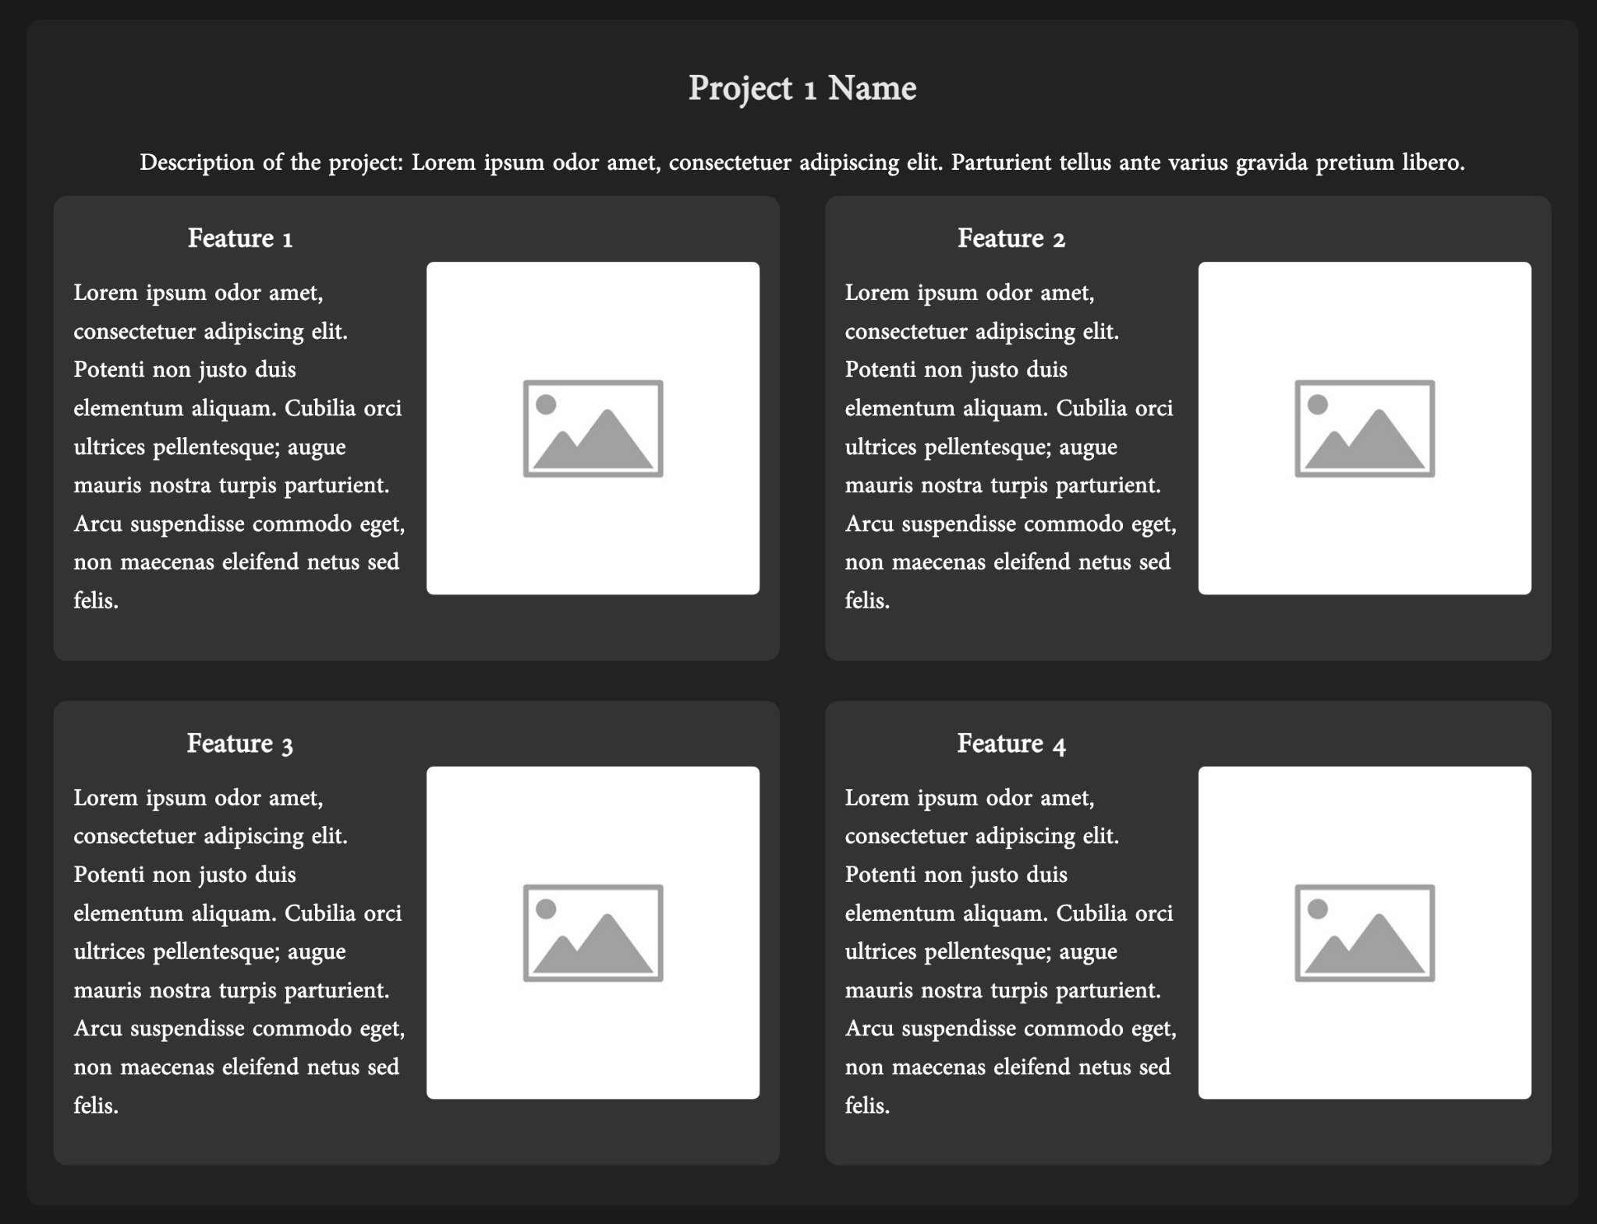

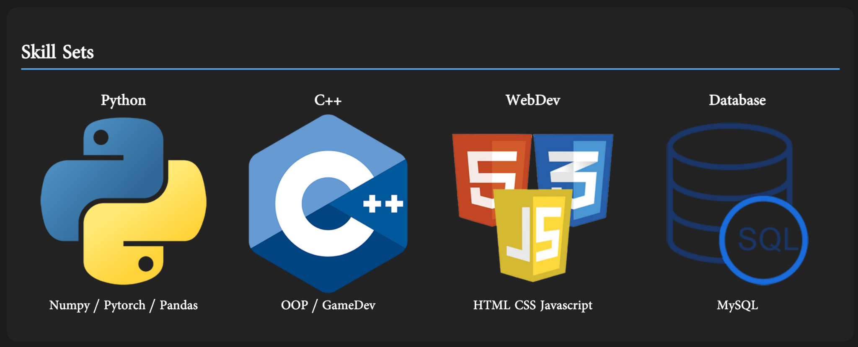
Eric Zhao
Progress
Page | 05

Slide 7
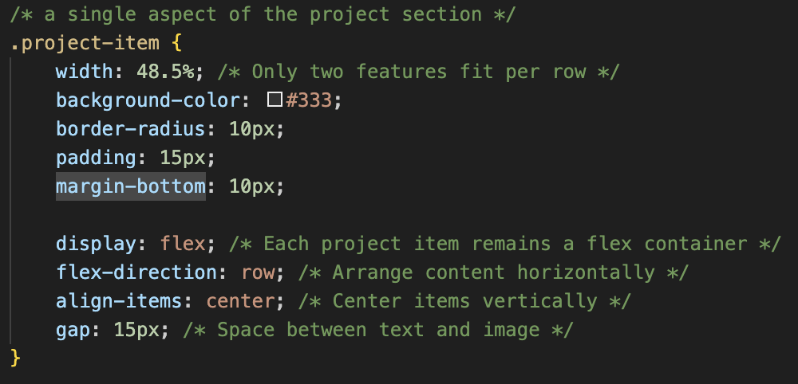
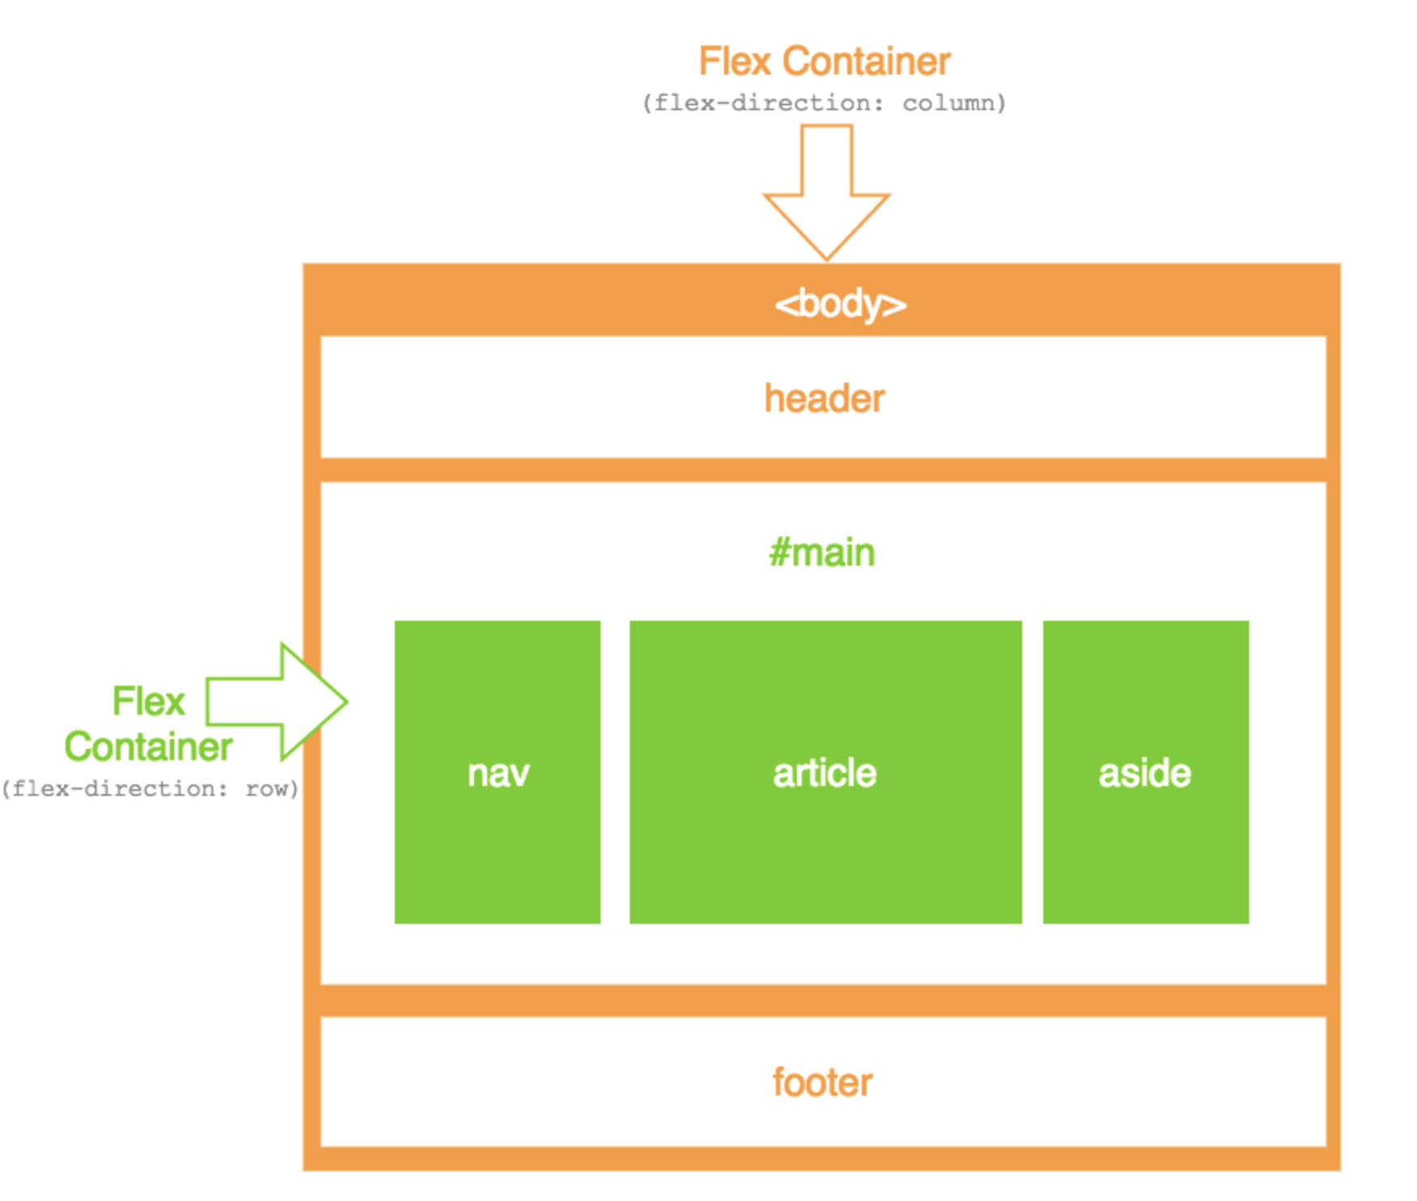
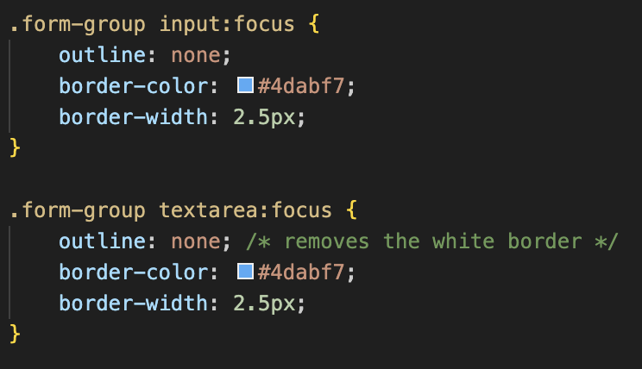
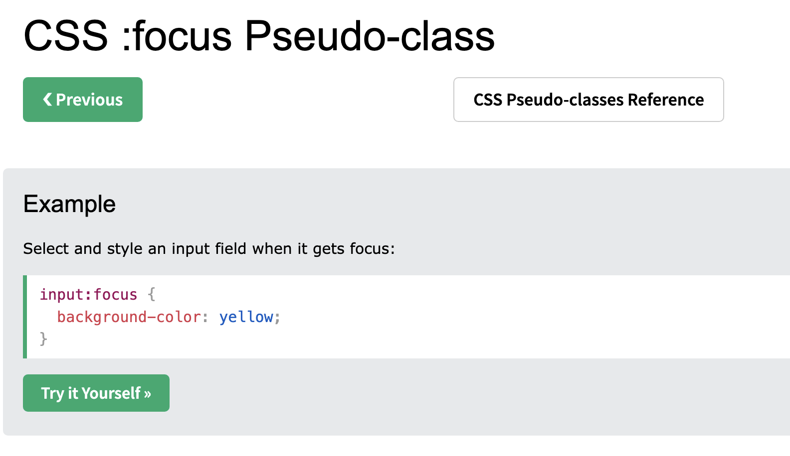
Eric Zhao
Code Snip
Page | 06

Slide 8

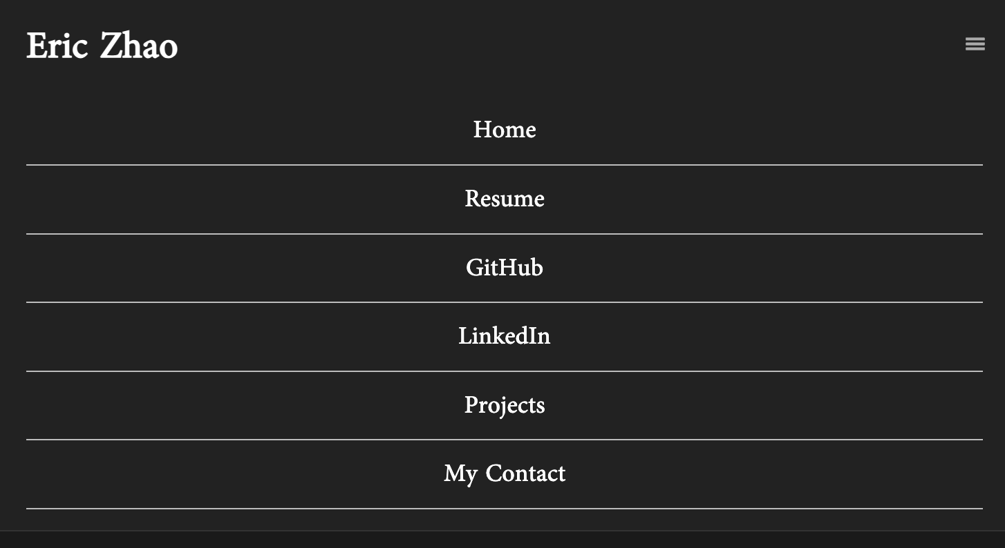
Eric Zhao
Media Query: Mobile
Page | 07

Slide 9

Eric Zhao
Next steps
Add in more animation
Add the scrolling effects
e.g. DJI Action 5 Website
Add Video Demonstrations of my project and make them interactive
Allow interaction with my projects
APIs
Online Games
Automatic updates
e.g. Performance of my portfolio
Complete my Resume page with a download button
Page | 08

Slide 10
<h2>Eric Zhao<h2>
<nav>
Home
Resume
GitHub
Projects
My Contact
</nav>
Resume
Download
Resume PDF
Page | 09

